Slide 1


LARAVEL INTRODUCTION
ABDUL WAHAB AMIR

Slide 2
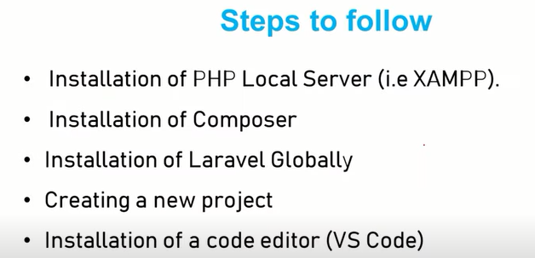


Slide 3

https://getcomposer.org/download/
A Composer is a tool that incorporates all the dependencies and libraries
It allows you to declare the libraries your project depends on and it will manage (install/update) them for you.
Third-party libraries can be installed in a project effortlessly utilizing composer.

Slide 4

https://laravel.com/docs/10.x/installation#your-first-laravel-project
Before creating your first Laravel project, you should ensure that your local machine has PHP and Composer installed
you may create new Laravel projects by globally installing the Laravel installer via Composer:
composer global require laravel/installer

Slide 5
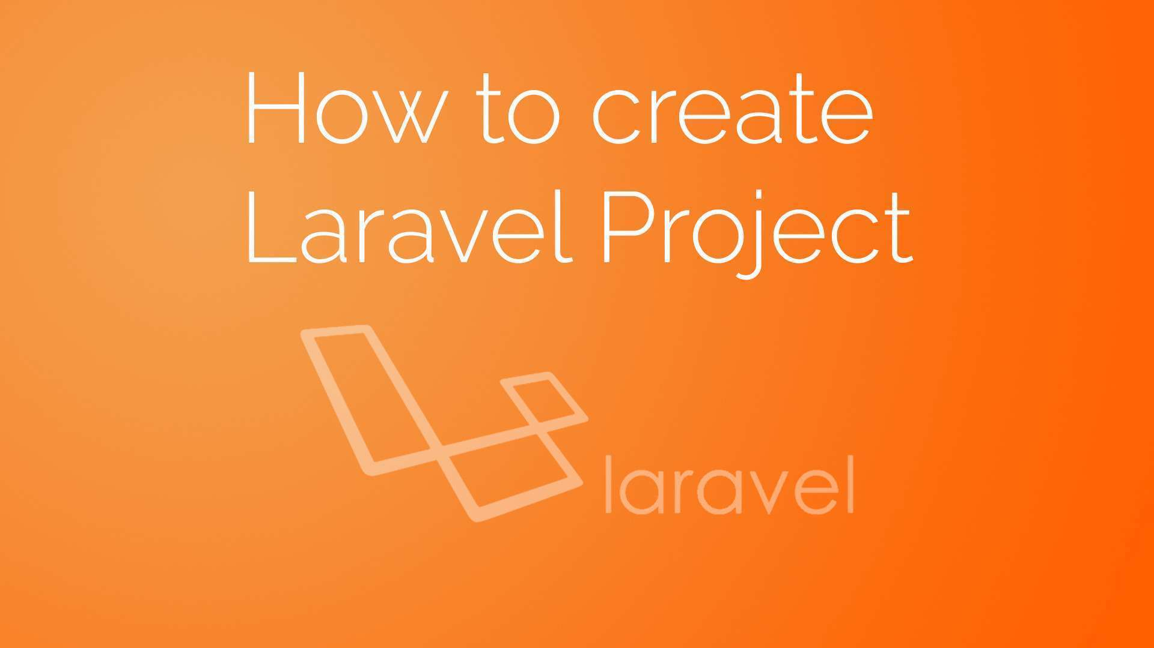
CREATING A FOLDER IN HTDOCS FOR LARAVEL PROJECT

Slide 6
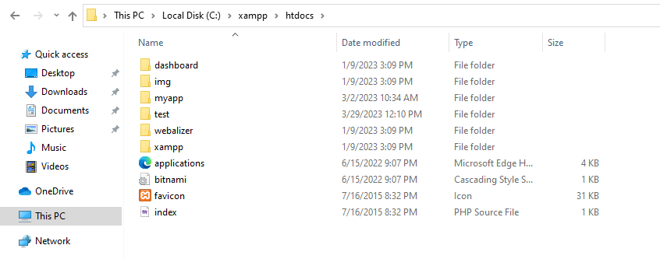
CREATING A FOLDER IN HTDOCS FOR LARAVEL PROJECT

Slide 7
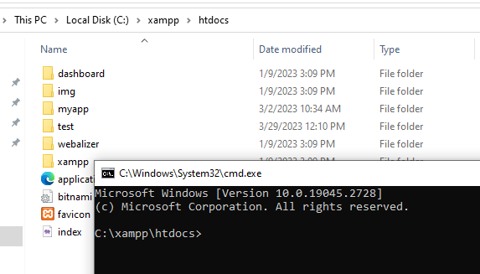
CREATING A FOLDER IN HTDOCS FOR LARAVEL PROJECT
Click on the path and cmd , so cmd will be open following that path

Slide 8
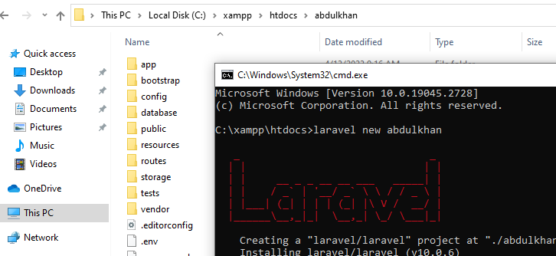
CREATING A FOLDER IN HTDOCS FOR LARAVEL PROJECT
Now put this for creating new project with your name
laravel new example-app

Slide 9
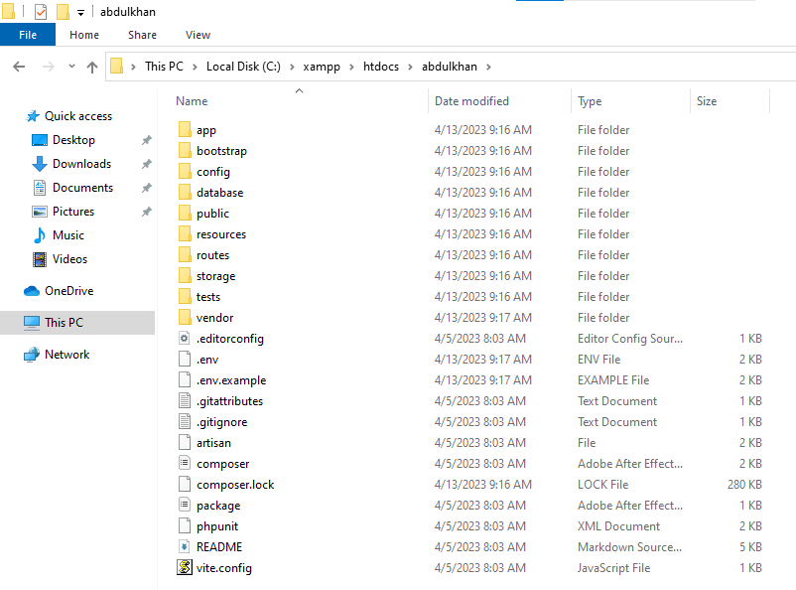
CREATING A FOLDER IN HTDOCS FOR LARAVEL PROJECT
Project laravel will be created with named abdulkhan

Slide 10
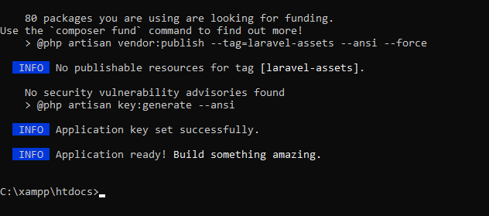
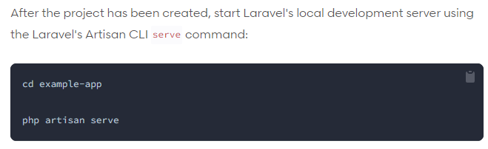
CREATING A FOLDER IN HTDOCS FOR LARAVEL PROJECT
NEW PROJCT WILL BE CREATED
THEN YOU NEED TO CREATE A LOCAL SERVER

Slide 11
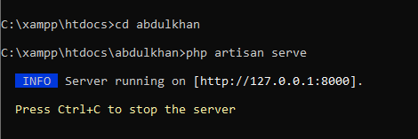
CREATING A FOLDER IN HTDOCS FOR LARAVEL PROJECT
You server is ready to use 😊😊

Slide 12
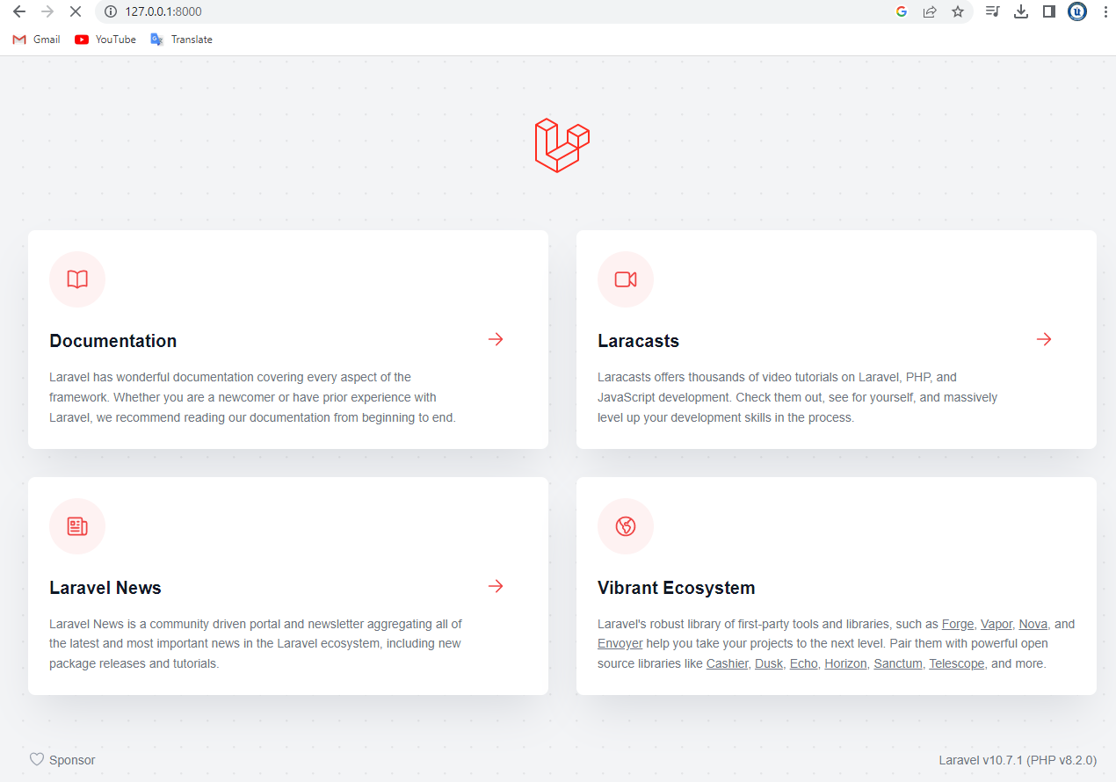
CREATING A FOLDER IN HTDOCS FOR LARAVEL PROJECT
✌✌✌✌

Slide 13
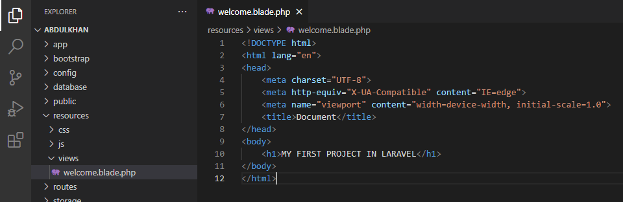

CREATING A FOLDER IN HTDOCS FOR LARAVEL PROJECT
REFERESH THE PAGE AND SEE THE OUTPUT

Slide 14
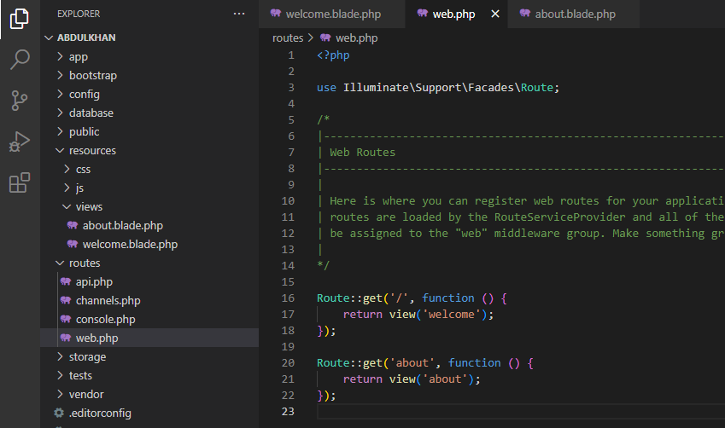
How Routes Works : Creating a about page

Slide 15
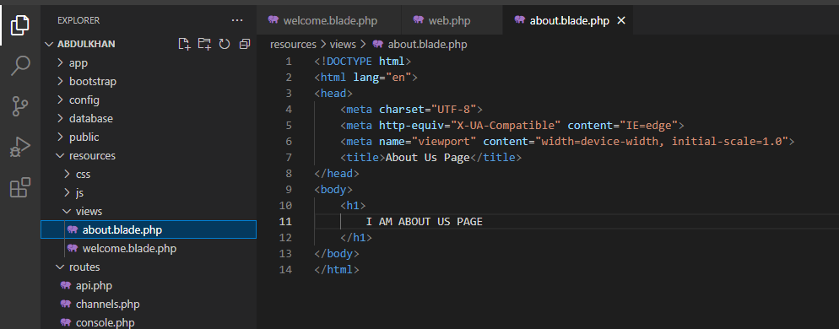

Go to resources / views and create about.blade.php

